Slide 1
Intel® IPP 2008
Integrated Performance Primitives
R. Wirt
SECR 2008
Boris Sabanin

Slide 2
Agenda
IPP Economics
Achieving performance
Why customers with IPP
Generated library is reality
Deferred mode image processing

Slide 3
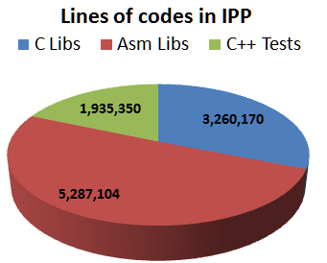
IPP Economics
16 functional domains
10K entry points
380MB source codes, 23MB docs
Design, development, testing, validation & packaging in Russia
IA32, Intel®64, IA64, Atom™
Windows, Linux, MacOSX, FreeBSD, QNX
2 Releases a year + updates + OOC releases
IPP $199, IPP samples $Zero. 35K customers

Slide 4
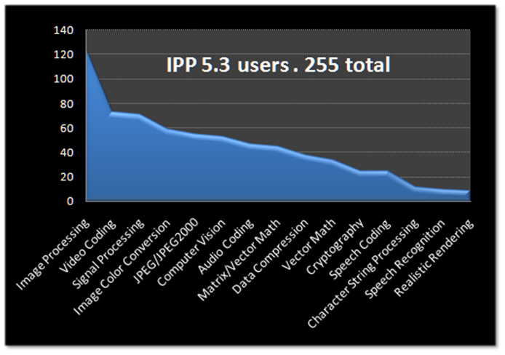
IPP Primitives
Signal & Image Processing
Speech, Audio & Video Coding
String Processing
Computer Vision
Speech Recognition
Jpeg & Jpeg2000
Lossless Data Compression
Cryptography
Realistic Rendering
Data Integrity
Vector Math, Small Matrix operations
Spiral. Automatically generated DSP transforms
IPP customer preferences

Slide 5
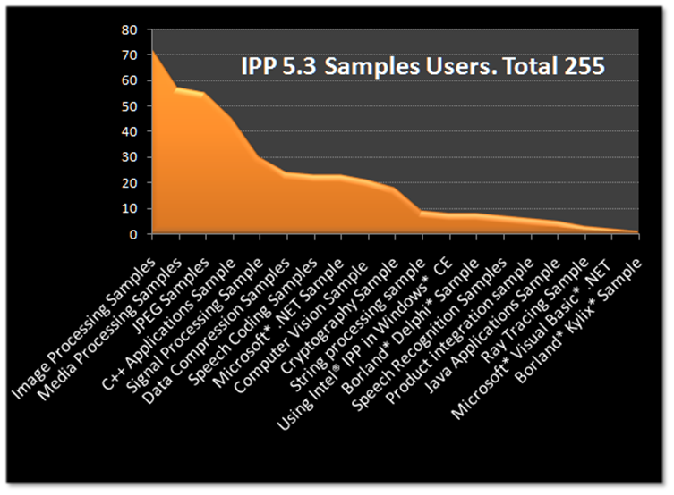
50+ IPP Samples
Video codecs: MPEG2, MPEG4, H264, VC1, AVS
Audio codecs: MP3, AAC, AC3
JPEG and JPEG2000 codecs
Speech codecs: G722, G723, G726, G728
Computer Vision: Face Detection
Deferred Mode Image processing
Ray Tracing viewer
Data Compression: GZIP,LZO,ZLIB,BZIP2
Interfaces: Java, C#, .VB, F90, C++
$0 cost IPP components are strong competitors to commercial products: Jpeg2000, H264, speech

Slide 6
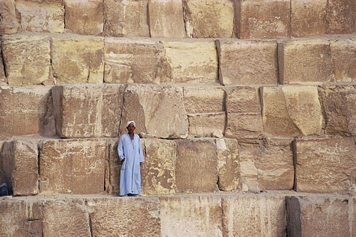
Why Primitives?
“Было бы расточительством и неграмотностью не предоставлять разработчикам общего фундамента для их [систем] построения.”
А.П.Ершов, "Математическое обеспечение 4-го поколения"
To optimize deeply
To make it cross-platform
To make it orthogonal in functionality
To test perfectly
To develop independently
To give customers the build blocks
Intel® Integrated Performance Primitives

Slide 7
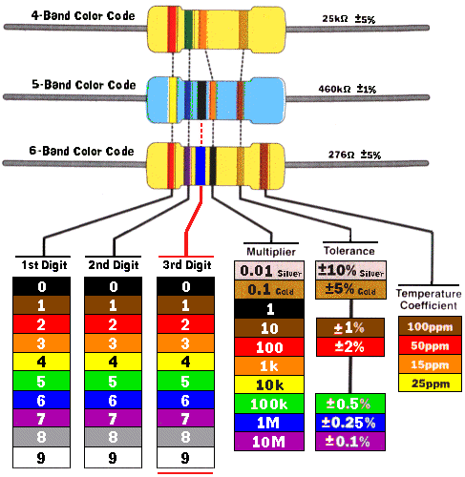
Being Primitive
ANSI C. Portable
Low overhead. High perf with small data
Low structure. No conversion
Basic common operation. For many ISV
Atomic. Making one thing. Build blocks, flexible
Self contained. Min or zero OS dependency
Predictable. Expectable behavior and results
Well defined. No “result is not defined”
Well documented. And self documented
Intuitive. Understand once
No magic. No side effects, explicit behavior
ippsAddC_8u_I

Slide 8
2008. IPP 6.0
High-level Data Compression LZO, zlib, gzip, bzip2
DMIP Deferred Mode Image Processing
AVS Decoder, ALS Decoder
MS RT Audio codec
Video Enhancement De - noising, interlacing, mosaicing
Image Search. MPEG7 descriptors: Edge Histogram & Color Layout
3D Support. Geometrical transform and Filtering
Reed-Solomon Coding in new IPP domain – Data Integrity
Optimization for Nehalem, Atom
Threaded Static Libraries, with new Intel OMP
Spiral generated library with DFT, WHT, and Hartley
IPP powered valarray for the Intel compiler package
Notes:
The edge histogram descriptor represents the spatial distribution of five types of edges (four directional edges and one non-directional
The MPEG-7 CLD visual descriptor is designed to represent the spatial distribution of the color features in an image. To satisfy this requirement, the CLD is obtained by applying the discrete cosine transform (DCT) in a 2-D image space.

Slide 9
IPP 2009
Optimization for the current &future architectures
3D image processing
Unified Image processing Classes UIC
Unicode in RegEx
New functionality generated by Spiral
Texture compression
Deferred Mode Image Processing
Unification of the library file names

Slide 10
Achieving Performance
Next IA always better
Algorithms
Cache utilization
SIMD
Threading
HW accelerators
Hybrid Solution

Slide 11
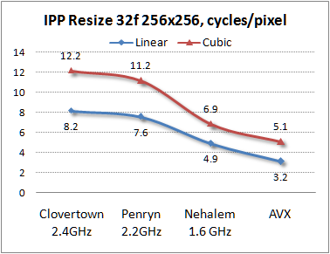
Better than previous
Intel architecture is improved with every new generation. For example, performance in CPU cycles/pixel of IPP Resize with the Linear & Cubic interpolation. SSSE3 code measured on 3 Intel platforms and SBR simulator.
Does the increased performance mean we can do nothing for optimization?

Slide 12
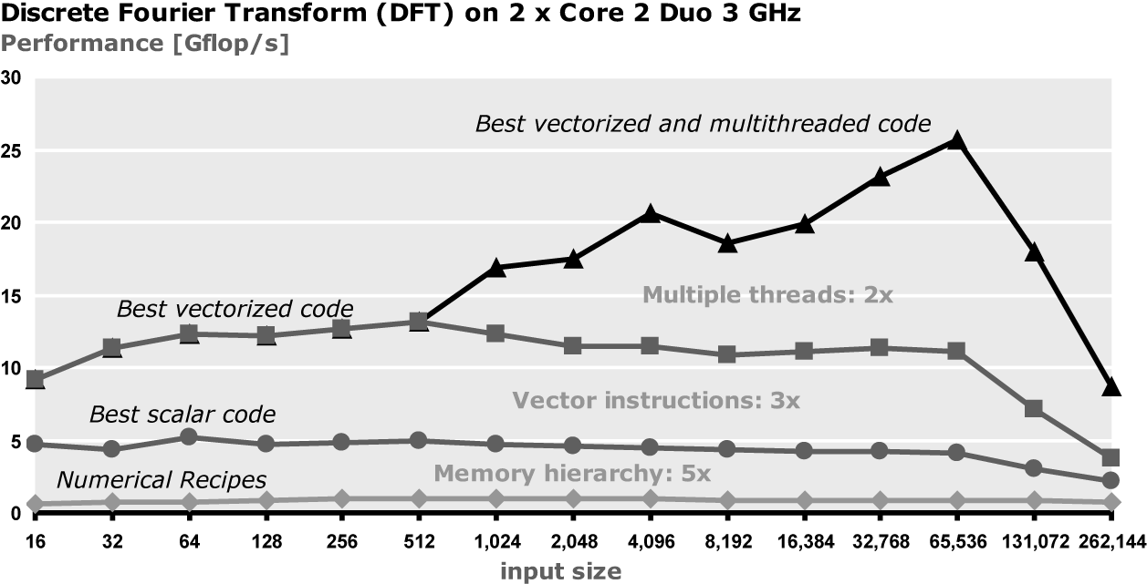
The Factors of Performance
Performance of DFT in GFlops. From “Numerical Recipes” code 1GFs to the best code with 25GFs

Slide 13
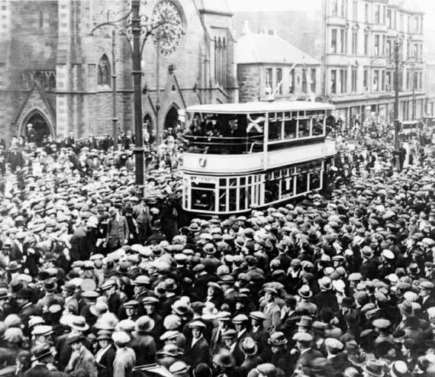
IPP Customers
Microsoft
Adobe
Philips Medical
MathWorks
Ulead
Thomson
Yahoo
OKI
Apple
Symantec
Pixar
Envivio
SGI
Oracle
SAP
Google
Harman Becker
Sony
Baidu

Slide 14
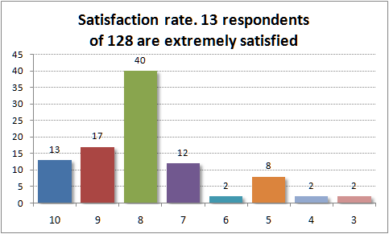
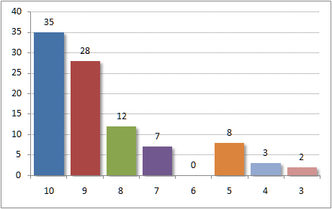
Why Customers with IPP?
The IPP 6.0 beta customer survey results.
128 answered. Level of satisfaction with IPP.
What is OK for my friend is not for me
Would recommend to a friend
Functionality
Performance
Quality

Slide 15
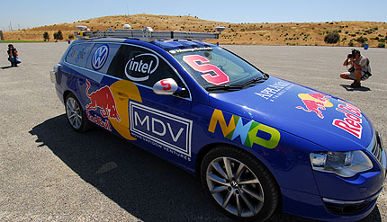
The Open Source Powered by IPP
Data Compression
GZIP, ZLIB, BZIP2, LZO
Image Coding. Jpeg
IJG
Cryptography
OpenSSL
Computer Vision
OpenCV

Slide 16
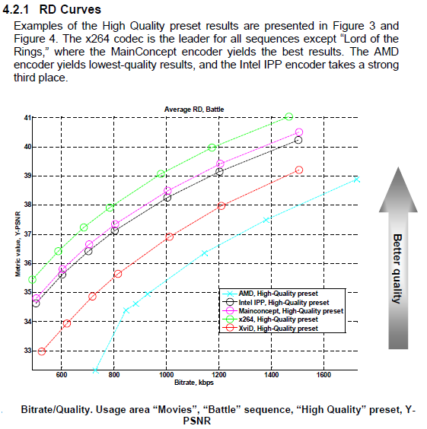
Quality and Performance
Having advantage in performance you can convert it to the quality.
MSU Graphics Lab
Reports IPP H.264 encoder is in top 3
MainConcept
IPP
x264

Slide 17
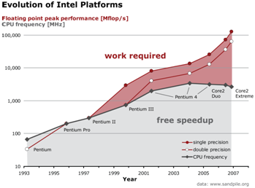
End of “free” speed-up for SW
Performance gain is not more achievable with the CPU frequency increase. Sophisticated optimization is needed

Slide 18
Automation is the only way
End of free speedup for legacy code we relied on in the past
Min num of operations doesn’t mean max performance
The performance difference between the best possible and straightforward implementations can be 10x and more
Difficult to write the possible fastest code
Performance is not portable
New architectures arrive quickly increasing the gap between HW capabilities and what SW exploits

Slide 19
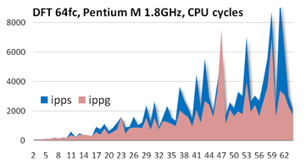
New IPP Domain Gen
The library is entirely computer generated
The tool generated ippg is Spiral, developed at Carnegie Mellon University
The library provides IPP users with new functionality and with ‘new’ performance
New functions: Hartley and Walsh-Hadamar transform
Higher performance functions for existing functionality: DFT

Slide 20
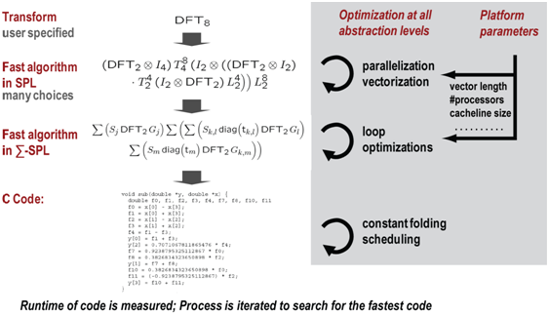
New Development Process
Spiral generates and evaluates many different possible algorithms represented in an internal math language
Spiral performs memory hierarchy optimization, vectorization, and parallelization for multi core by rewriting math expressions
Spiral outputs the fastest found code which is often faster than hand optimized code

Slide 21
Quick Adaptation to New Architecture
Since the entire process is automated it is possible to quickly move to new platforms with new SSE extension by regenerating the code
An example. New vector architecture AVX was announced on April 4th. After 3 weeks Spiral started generating AVX code for DFT & WHT IPP functions

Slide 22
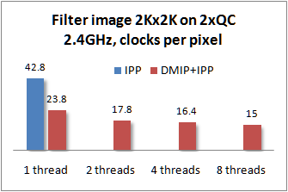
Deferred Mode Image Processing
Utilize knowledge about application specifics
Call highly optimized IPP
Reuse data in the cache
Run in parallel. Data & operation level parallelization
Transmit a graph for the execution
Problem with IPP: Every function operates on a whole image, which is bigger than L2, evicting data the next operation needs

Slide 23
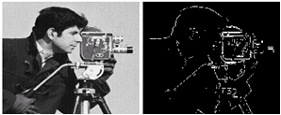
Usual Approach. Edge Detection with IPP
D=Add(Abs(SobelH(S)),Abs(SobelV(S)))
S & D are the source and destination images
SobelH is a Sobel filter applied to image rows
SobelV is a Sobel filter applied to image columns
Operation | L2 full of | L2 Data Reuse
A=ippSobelH(S) | S, A | 0
A=ippAbs(A) | A | 0
B=ippSobelV(S) | S, B | 0
B=ippAbs(B) | B | 0
D=B=ippAdd(A,B) | A, B | 0
A
L2
Abs(A)

Slide 24
DMIP. Slice Processing. Utilize Cache
Symbolic level
image: D=Add(Abs(Sh(S)),Abs(Sv(S)))
i-th slice: Di=Add(Abs(Sh(Si)),Abs(Sv(Si)))
Si
Sh
Given L2 size, define a size of the slice to process by
Build and compile a graph
Execute the graph calling IPP functions
Vary slice
Vary image
Abs
A
a
Sv
Operation | L2 full of | L2 Reuse
a=ippSh(Si) | a, Si | 0
a=ippAbs(a) | a, Si | 1
b=ippSv(Si) | b, Si | 0.5
b=ippAbs(b) | b, Si | 1
Di=b=ippAdd(a,b) | b, a | 0.5
Abs
Add
L2
a
b
Di

Slide 25
DMIP. The Host-Client Mode
Image D=Add(Abs(Sh(S)),Abs(Sv(S)))
Slice Di=Add(Abs(Sh(Si)),Abs(Sv(Si)))
tslice Dit=Add(Abs(Sh(Sit)),Abs(Sv(Sit)))
Si
Given L2 size, num of threads
Define the image slice size
Compile the expression and build a graph
Serialize graph and send to GPU
CPU
Sv
Sh
Execute the graph calling IPP functions
Vary slice
Serialize results and send to CPU
IPP
Abs
Abs
GPU
Operation
a=ippSh(Si); b=ippSv(Si)
a=ippAbs(a); b=ippAbs(b)
b=ippAdd(a,b)
T0
T1
Tm
Add
T0
T1
Tm
T0
T1
Tn
Di
Operator and Data parallel mode

Slide 26
Open for Feature Requests
IPP 2008 delivered customers a number of new features
Deferred Mode Image Processing
New IPP domain with high performance primitives generated automatically
High level Data Compression functionality
Data Integrity functionality
Most of the features are implemented because IPP customers request
You can request too
You can get IPP there http://www3.intel.com/cd/software/products/asmo-na/eng/perflib/219780.htm
You can participate IPP forum http://software.intel.com/en-us/forums
You can buy IPP books at Amazon http://www.amazon.co.uk/Optimizing-Applications-Multi-Core-Processors-Performance/dp/1934053015
Notes:
http://www3.intel.com/cd/software/products/asmo-na/eng/perflib/219780.htm
http://software.intel.com/en-us/forums
http://www.amazon.co.uk/Optimizing-Applications-Multi-Core-Processors-Performance/dp/1934053015

Slide 27
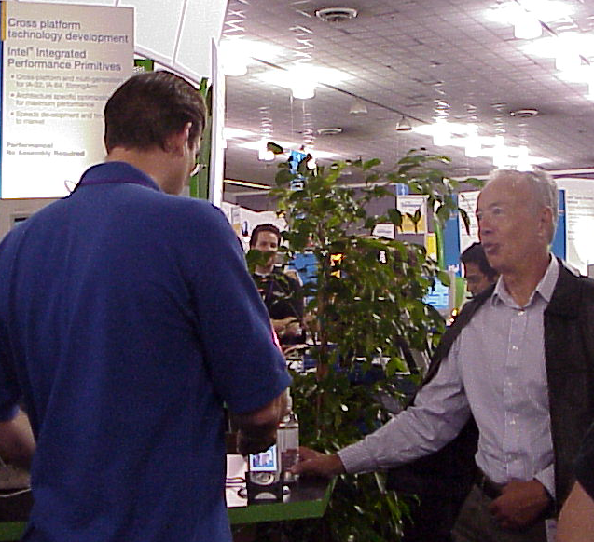
A Bottle of IPP
IPP demo application running on iPAQ is presented to Andy Grove at IDF 2003

Slide 28
“Strategy Is Destiny” by Robert A.Burgelman
Page 236
‘In the early 1990s Intel Architecture Labs created Native Signal Processing (NSP). Through NSP, Intel would create multimedia capabilities through the microprocessor itself, creating new a new platform standard, which would help the multimedia application software developers. NSP, however, would not only displace pieces of hardware, but software as well. NSP invisibly enhanced MS Windows by controlling the manner in which the Premium allocated its time, resulting in a better multimedia experience.
MS, however, was not pleased with this development and this initiative disappeared at Intel. Some time later, Andy Grove in a conversation with Bill Gates explained the decision to stop the NSP applications: "We caved. Introducing a Windows-based software initiative that MS doesn't support … well, life is too short for that.“’
NSP is a predecessor of IPP developed by the same team

